Slide 1
OOPS, Java Introduction & Language Fundamentals
Inheritance & Polymorphism

Slide 2
OOPS
Abstraction
Encapsulation
Inheritance
Polymorphism
Compile-time polymorphism
Runtime polymorphism
Class
Object

Slide 3
Primitive Data Types
The Java programming language is statically-typed, which means that all variables must first be declared before they can be used.
The Java programming language supports seven other primitive data types.
A primitive type is predefined by the language and is named by a reserved keyword.

Slide 4
Primitive Data Types
int: By default, the int data type is a 32-bit signed two's complement integer, which has a minimum value of -2³¹ and a maximum value of 2³¹-1.
long: The long data type is a 64-bit two's complement integer.
float: The float data type is a single-precision 32-bit IEEE 754 floating point. double: The double data type is a double-precision 64-bit IEEE 754 floating point.
boolean:
Primitive values do not share state with other primitive values. The eight primitive data types supported by the Java programming language are:
byte: The byte data type is an 8-bit signed two's complement integer. It has a minimum value of -128 and a maximum value of 127 (inclusive). short: The short data type is a 16-bit signed two's complement integer. It has a minimum value of -32,768 and a maximum value of 32,767 (inclusive)..

Slide 5
Primitive Data type
Data Type | Size | Description
byte | 1 byte | Stores whole numbers from -128 to 127
short | 2 bytes | Stores whole numbers from -32,768 to 32,767
int | 4 bytes | Stores whole numbers from -2,147,483,648 to 2,147,483,647
long | 8 bytes | Stores whole numbers from -9,223,372,036,854,775,808 to 9,223,372,036,854,775,807
float | 4 bytes | Stores fractional numbers. Sufficient for storing 6 to 7 decimal digits
double | 8 bytes | Stores fractional numbers. Sufficient for storing 15 decimal digits
boolean | 1 bit | Stores true or false values
char | 2 bytes | Stores a single character/letter or ASCII values

Slide 6
Default Value
Data Type | Default Value (for fields)
byte | 0
short | 0
int | 0
long | 0L
float | 0.0f
double | 0.0d
char | '\u0000'
String (or any object) | null
boolean | false

Slide 7
CONSTRUCTORS
Use class name and no return type
Non-arg and parameterized constructor
Compiler providing default const
public Bicycle(int startCadence, int startSpeed, int startGear) { gear = startGear; cadence = startCadence; speed = startSpeed; }
Bicycle myBike = new Bicycle(30, 0, 8);

Slide 8
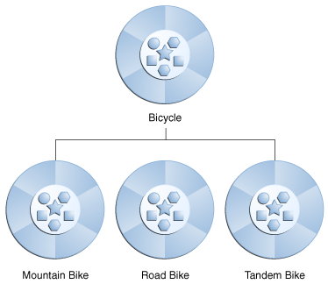
Inheritance

Slide 9
Inheritance
class MountainBike extends Bicycle {
// new fields and methods defining // a mountain bike would go here
}

Slide 10
Interface
objects define their interaction with the outside world through the methods that they expose
Methods form the object's interface with the outside world; E.G:television set
In its most common form, an interface is a group of related methods with empty bodies

Slide 11
Interface
interface Bicycle { // wheel revolutions per minute
void changeCadence(int newValue);
void changeGear(int newValue);
void speedUp(int increment);
void applyBrakes(int decrement); }

Slide 12
MV
Member variables in a class—these are called fields.
Variables in a method or block of code—these are called local variables.
Variables in method declarations—these are called parameters.

Slide 13
Naming
Naming
Every programming language has its own set of rules and conventions for the kinds of names that you're allowed to use, and the Java programming language is no different. The rules and conventions for naming your variables can be summarized as follows:
Variable names are case-sensitive. A variable's name can be any legal identifier — an unlimited-length sequence of Unicode letters and digits, beginning with a letter, the dollar sign "$", or the underscore character "_". The convention, however, is to always begin your variable names with a letter, not "$" or "_". Additionally, the dollar sign character, by convention, is never used at all. You may find some situations where auto-generated names will contain the dollar sign, but your variable names should always avoid using it. A similar convention exists for the underscore character; while it's technically legal to begin your variable's name with "_", this practice is discouraged. White space is not permitted.
Subsequent characters may be letters, digits, dollar signs, or underscore characters. Conventions (and common sense) apply to this rule as well. When choosing a name for your variables, use full words instead of cryptic abbreviations. Doing so will make your code easier to read and understand. In many cases it will also make your code self-documenting; fields named cadence, speed, and gear, for example, are much more intuitive than abbreviated versions, such as s, c, and g. Also keep in mind that the name you choose must not be a keyword or reserved word.
If the name you choose consists of only one word, spell that word in all lowercase letters. If it consists of more than one word, capitalize the first letter of each subsequent word. The names gearRatio and currentGear are prime examples of this convention. If your variable stores a constant value, such as static final int NUM_GEARS = 6, the convention changes slightly, capitalizing every letter and separating subsequent words with the underscore character. By convention, the underscore character is never used elsewhere.

Slide 14
Encapsulation
It is common to make fields private
Access? This can be done indirectly by adding public methods that obtain the field values for us.

Slide 15
Polymorphism
Function Overloading
Function Overriding
number and the type of the arguments
Compiler – does not consider return type

Slide 16
The Garbage Collector
Java runtime environment has a garbage collector that periodically frees the memory used by objects that are no longer referenced. The garbage collector does its job automatically when it determines that the time is right.

Slide 17
this Keyword
Within an instance method or a constructor, this is a reference to the current object
public class Point { public int x = 0; public int y = 0; //constructor
public Point(int x, int y) { this.x = x; this.y = y; }
}

Slide 18
Understanding Class Members
INSTANCE VARIABLES
objects are created from the same class blueprint
variables that are common to all objects?
static modifier
public class Bicycle { private int cadence; private int gear; private int speed;
// add an instance variable for the object ID private int id;
// add a class variable for the
// number of Bicycle objects instantiated
private static int numberOfBicycles = 0; ... }

Slide 19
Class variables are referenced by the class name itself, as in
Bicycle.numberOfBicycles
This makes it clear that they are class variables.
Note: You can also refer to static fields with an object reference likemyBike.numberOfBicycles
but this is discouraged because it does not make it clear that they are class variables.

Slide 20
Static method access
Instance methods can access instance variables and instance methods directly.
Instance methods can access class variables and class methods directly.
Class methods can access class variables and class methods directly.
Class methods cannot access instance variables or instance methods directly—they must use an object reference. Also, class methods cannot use the this keyword as there is no instance for this to refer to.

Slide 21
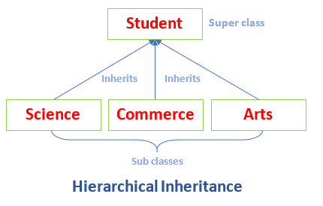
Hierarchical Inheritance

Slide 22
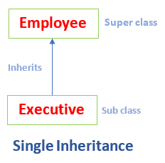
Single Inheritance

Slide 23
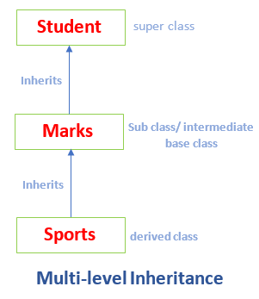
Multi-level Inheritance

Slide 24
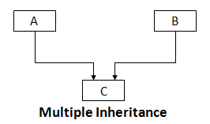
Multiple Inheritance

Slide 25
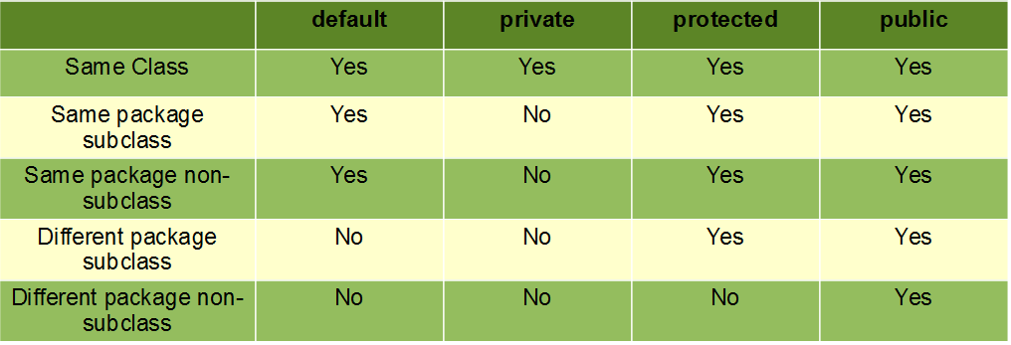
Access Specifiers

Slide 26
Access level modifiers
At the top level—public, or package-private (no explicit modifier).
At the member level—public, private, protected, or package-private (no explicit modifier).

